Slide 1

Libra Summer School and Workshop 2024
Alexey Akimov, Sophya Garashchuk, Mohammad Shakiba, Daeho Han, Qingxin Zhang
University at Buffalo, SUNY
July 8, 2024

Slide 2
Libra Overview

Slide 3


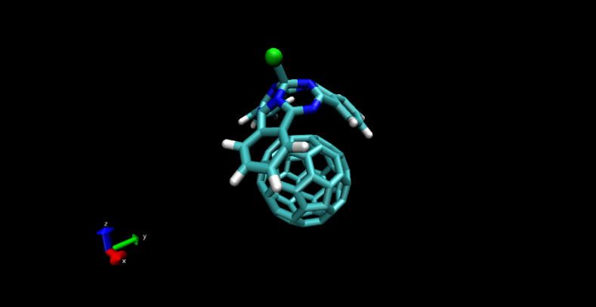
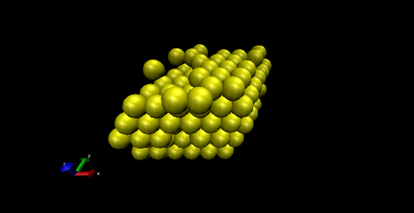
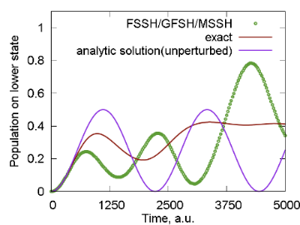
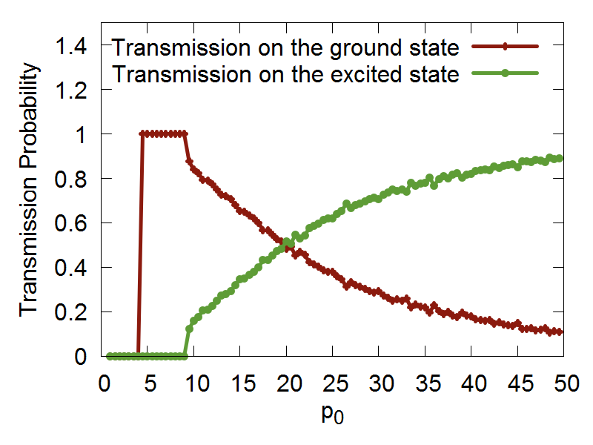
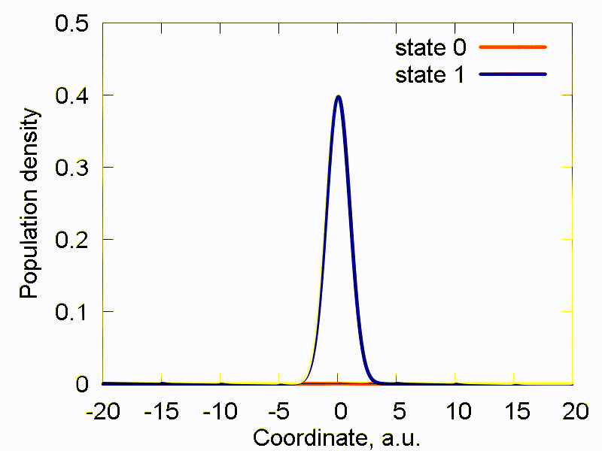
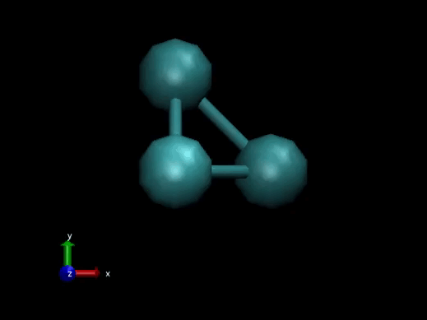
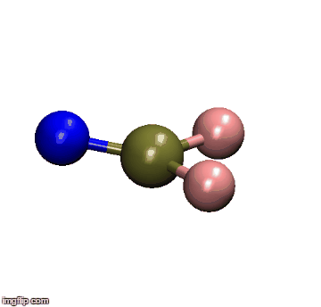
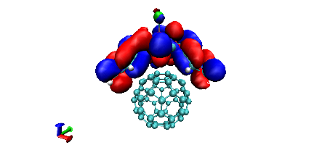
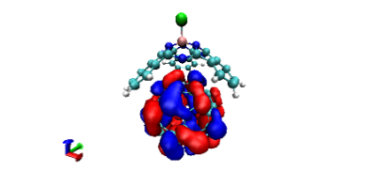
Libra History
Classical MD
Libra-X (with Drs. Ryoji Asahi, Kosuke Sato, Ekadashi Pradhan)
Sato, Pradhan, Asahi, Akimov PCCP 2018, 20, 25275
Pradhan, Sato, Akimov J. Phys.: Condens. Matter, 2018, 30, 484002
Interfaces with GAMESS, QE
Added back-reaction for QE
More modularization
Akimov, Prezhdo, JCTC, 2013, 9, 4959.
Akimov, Prezhdo, JCTC, 2014, 10, 789
Akimov JCC, 2016, 37, 1626
Ehrenfest & TSH
DVR
Back-reaction
Rigid body MD
Simplectic integrators for classical DOFs
Thermostats
Barostats
Force fields
ANN
Chemical object representation
Modularization and revision
DVR methods
Semiempirical Hamiltonians
Molecular integrals
Decoherence methods, TSH
Simplectic integrators for TDSE
TSH, Ehrenfest, stand-alone scripts
Decoherence methods
Model problems
Added HF and EHT to LCCCS
Interface with VASP, then QE
Pyxaid2 (with Prof. Wei Li)
Li, Zhou, Prezhdo, Akimov ACS Energy Lett, 2018, 3, 2159
SOC, multiple k-points, etc.
2007-2011
(LCCCS)
2011-2015
(Pyxaid)
2015/2016
(Libra)
2018
(Pyxaid2, Libra-X)

Slide 4
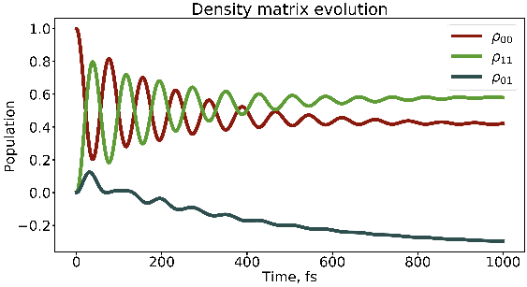
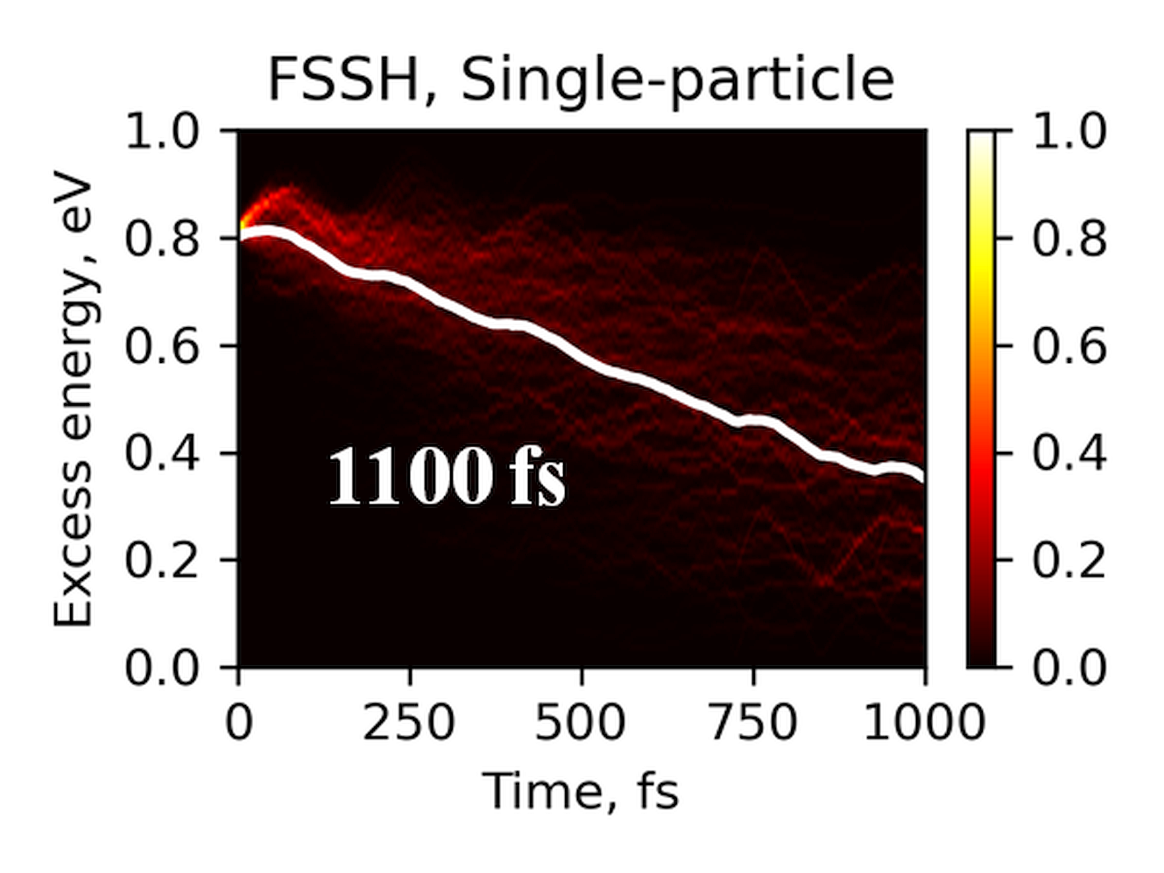
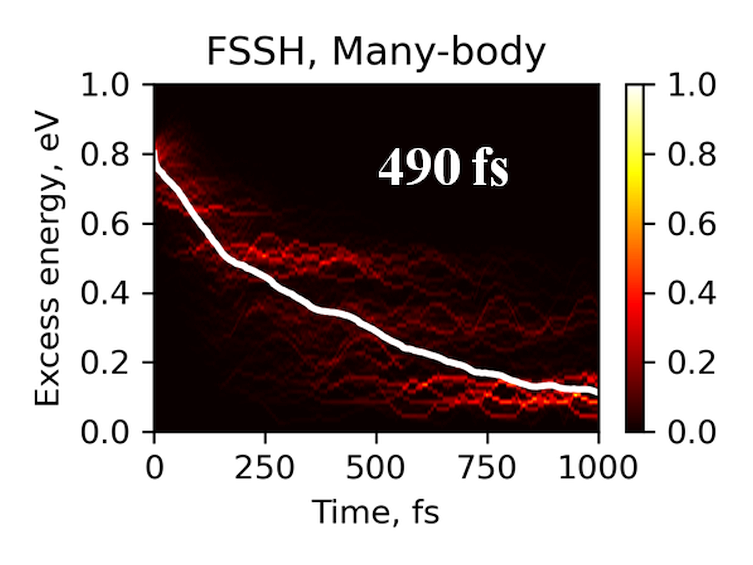
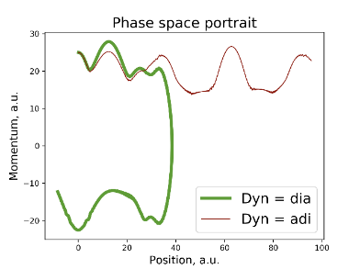
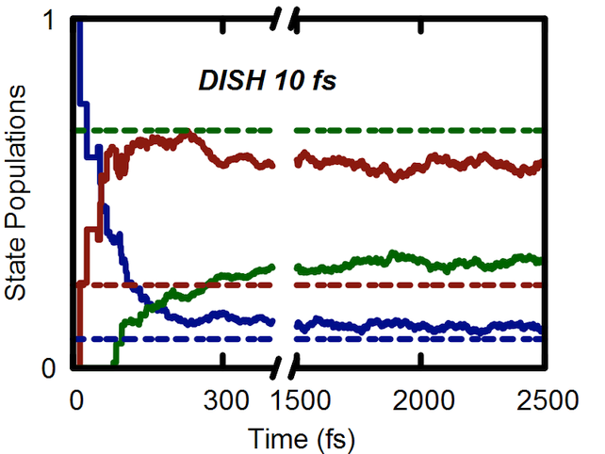
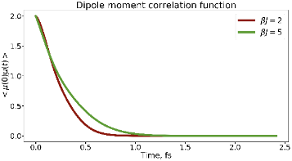
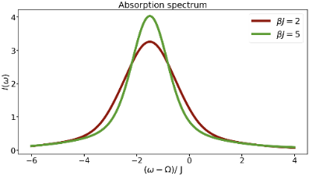
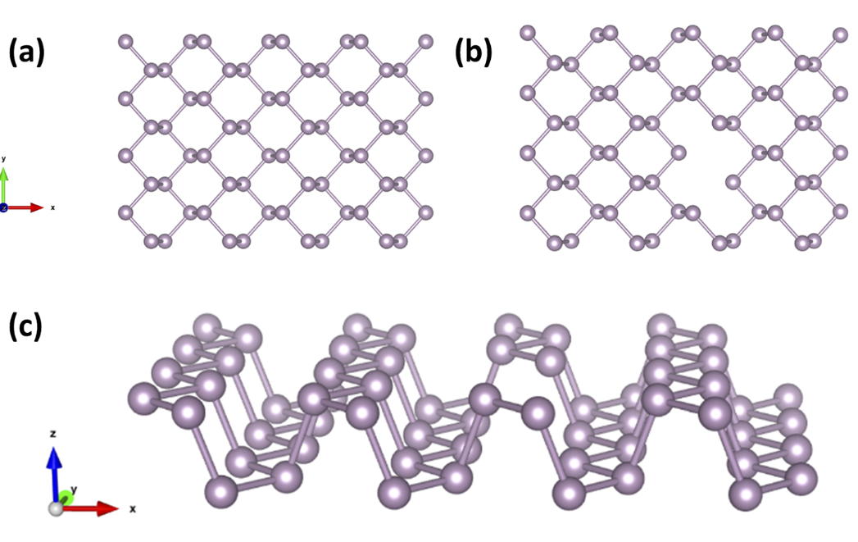
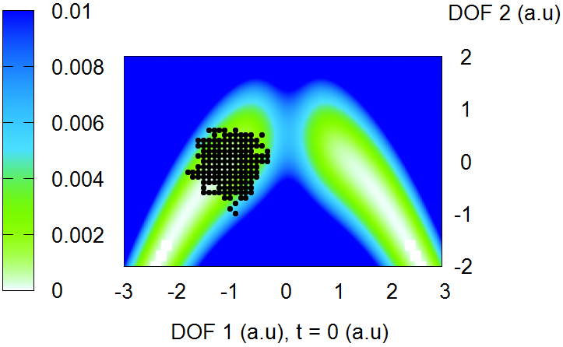
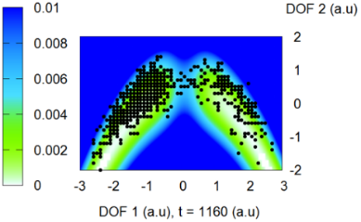
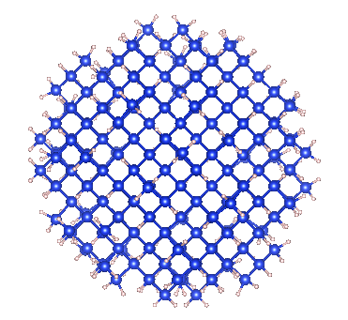
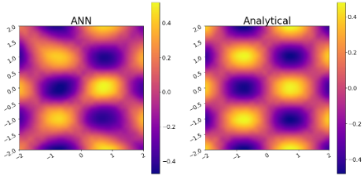
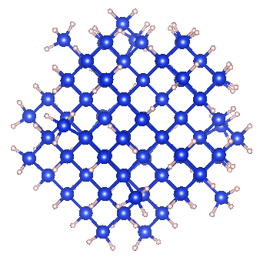
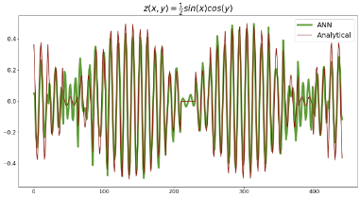
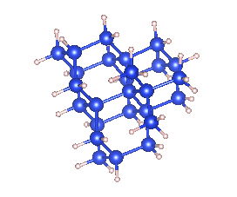
Libra History
Bastida’s Boltzmann-corrected Ehrenfest, mSDM
HEOM
Many-body (TD-DFT) NA-MD
Phase correction for NACs
Temen, Jain, Akimov Int. J. Quant. Chem., 2020, 120, e26373
Smith, B.; Shakiba, M.; AVA JCTC 2021, 17, 678
Smith, B.; Shakiba, M.; AVA JPCL 2021, 12, 2444
Akimov JPCL 2018 9, 6096-6102
Smith; Akimov JCP 2019, 151, 124107
Revised DISH, new workflows
Akimov JCP 2021, 155, 134106
Entangled trajectories
Smith, Akimov JCP 2018, 148, 144106
Belyaev-Lebedev LZ method
Machine Learning revised.
TD-ML approach
Smith, B.; Akimov, A. V JPCL 2020, 11, 1456-1465
Akimov JPCL 2021, 12, 12119
2018
2019
2020
2021

Slide 5
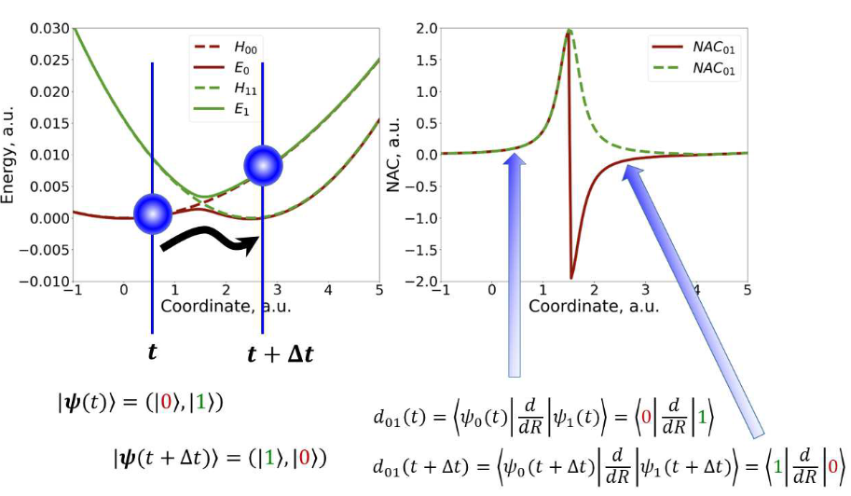

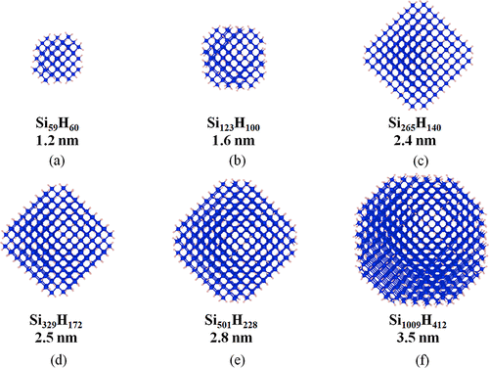
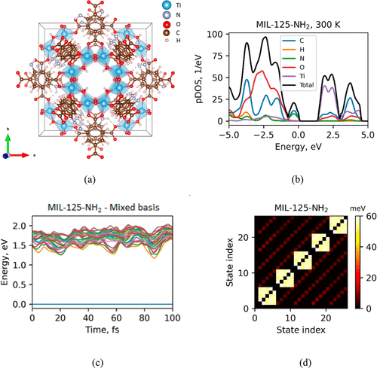
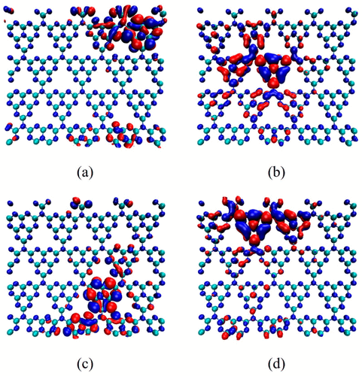
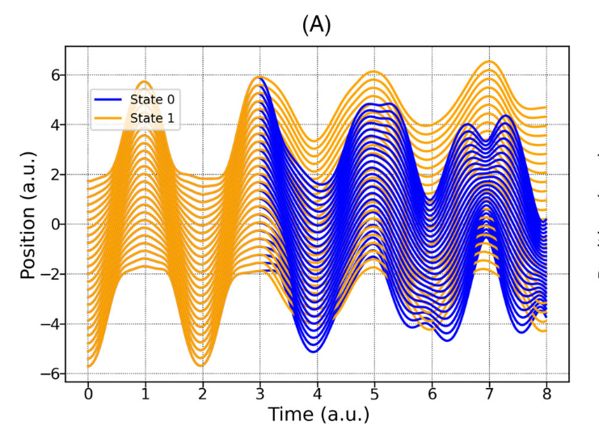
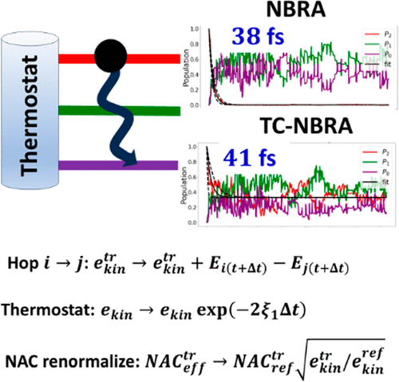
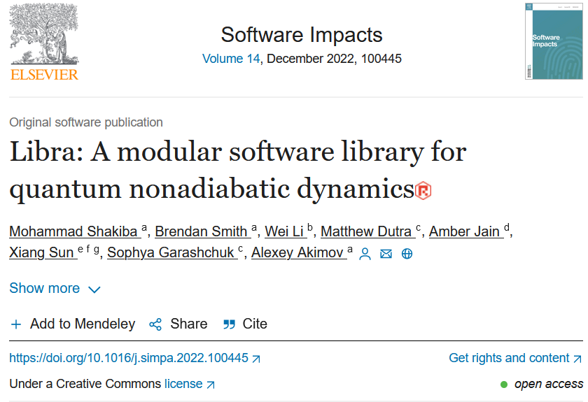
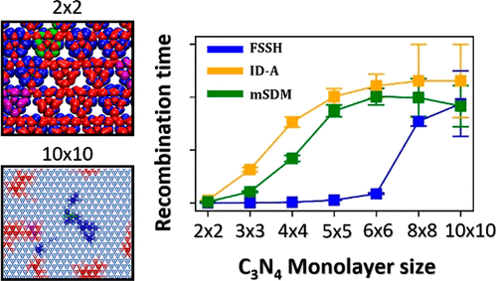
Libra History
NA-MD with xTB – applications to large systems
Also: effect of spin-adaptation
Generalized Local-Diabatization approach is adopted. New integrators. Liouville’s formalism
Shakiba, M.; Stippel, E.; Li, W.; Akimov, A. V. JCTC 2022 18, 5157
Shakiba, M.; Akimov, A.V. TCA 2023 142, 68
QTAG added
Dutra, M.; Garshchuk, S.; Akimov, A. IJQC 2023. 123, e27078
TC-NBRA workflow
Shakiba, M.; Smith, B.; Li, W.; Dutra, M.; Jain, A.; Sun, X.; Garashchuk, S.; Akimov, A.V. Software Impacts 2022 14, 100445
Akimov, A.V. JPCL 2023 14, 11673
https://codeocean.com/capsule/4727375/tree/v1
NA-MD with xTB: dependence of rates on carrier concentration
Shakiba, M.; Akimov, A.V. JPCC 2023 127, 9083
2022
2023

Slide 6
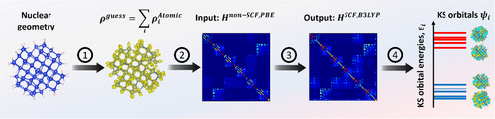


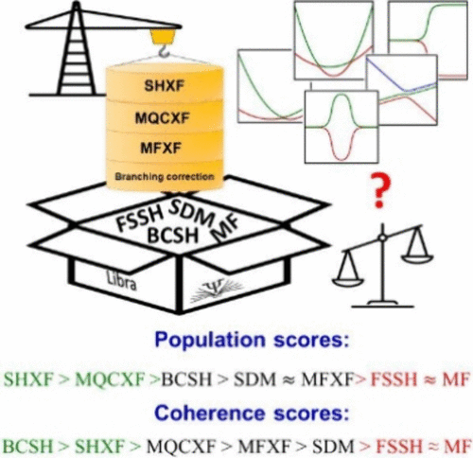
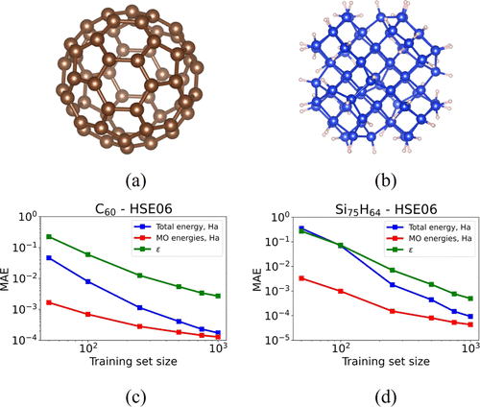
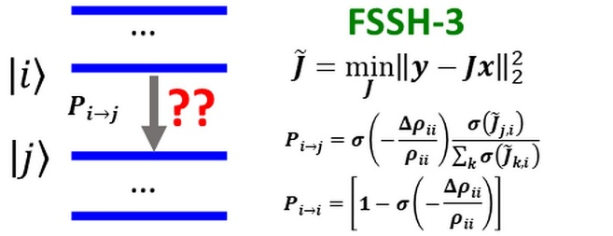
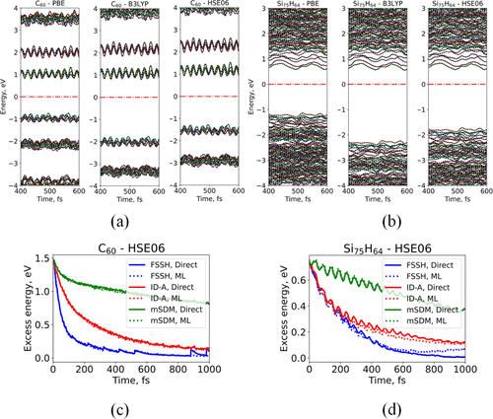
Libra History
Theory of many methods available (and yet to be added) in Libra:
Akimov, A. V. "Fundamentals of Trajectory-Based Methods for Nonadiabatic Dynamics" Editor(s): Manuel Yáñez, Russell J. Boyd, Comprehensive Computational Chemistry (First Edition), Elsevier 2024 Pages 235-272, ISBN 9780128232569, link Book Chapter in Book: "Comprehensive Computational Chemistry"
Exact factorization
Also, re-validated Ehrenfest and integrators, state tracking and phases
Libra/eQE interface – application to crystalline pentacene; IDF, DISH_rev2023
ML for KS Hamiltonian mapping
Shakiba, M.; Akimov, A.V. JCTC 2024 20, 2992
Zhang, Q.; Shao, X.; Li, W.; Mi, W.; Pavanello, M.; Akimov, A. V. JPCM 2024 36, 385901
Han, D.; Akimov, A.V. JCTC 2024 20, 5022
FSSH3, FSSH2
Akimov, A. V. Mol. Phys. 2024 (accepted)
Unpublished: MASH, QTSH, removal of rotation/translation, state selection
2024

Slide 7
Libra Philosophy/Vision
modular
Maximize and simplify the re-use, OOP
linear algebra, integrals,
quantum and classical mechanics/dynamics,
nonadiabatic methods, surface hopping,
IO utilities, model preparation and analysis
versatile
“methodology discovery”
Use with model problems and atomistic simulations
Python – for convenience, C++ - for efficiency
(prototyping)
practical
Fully-functional tool that can be applied to real (atomistic) systems to study materials
user-friendly & documented
The code is convenient to users and they have plenty resources – examples and documentation
A platform to adopt the past and latest developments
The developers can understand and contribute to the code
community tool
Notes:
So that is what Libra is essentially about..
To give you a more practical idea of how these design principles are implemented, lets discuss several modules..

Slide 8
Versatile: Methods and Algorithms
Representations:
adiabatic
diabatic
Representations:
amplitudes (TD-SE)
density matrix (Liouville)
Dynamics:
adiabatic
Mean-field-like: Ehrenfest, MFSD, MASH
TSH: FSSH, FSSH2, FSSH3, GFSH
Exact factorization: SHXF, MQCXF, MFXF
Decoherence: DISH, DISH_rev2023, IDA, IDF, SDM, mSDM, BCSH
Coupled trajectories-like: ETHD, QTSH
NAC-free: LZ, ZN, BLLZ
Wavepackets: QTAG
Exact grid: SOFT, Colbert-Miller
Exact system-bath: HEOM
Integrators:
RK4 (electronic, general)
rotations-based (electronic)
exponentiation (electronic)
Verlet (nuclear)
Integrators:
NAC-based
LD-based
Phase/state tracking:
Phase correction
Tracking: Munkres-Kuhn (Hungarian)/mincost
Initial conditions sampling:
In adiabatic/in diabatic
Momenta/coordinates
Gaussian/Wigner/arbitrary
Voronoi tessellation
Ensembles:
NVE
NVT (Nose-Hoover, Nose-Poincare)
Initial conditions sampling:
In adiabatic/in diabatic
Momenta/coordinates
Gaussian/Wigner/arbitrary
Voronoi tessellation
Other things:
Force fields (UFF, GAFF, etc.)
Semiempirics (INDO, EHT, etc.)
Molecule transformations
Rotation/translation removal
Rigid body dynamics
Workflows: model and atomistic; NBRA or not
Interfaces with: CP2K, DFTB+, ORCA, Gaussian, GAMESS, eQE, QE, Ergo, etc.

Slide 9
Libra as a workhorse of our developments
Implemented in Libra: https://quantum-dynamics-hub.github.io/libra/index.html
https://github.com/Quantum-Dynamics-Hub/libra-code
Akimov JCC, 2016, 37, 1626
Examples& Tutorials: https://github.com/compchem-cybertraining
Some of the implemented methods:
Methods | Paper
Surface hopping schemes | Tully, J. C. J. Chem. Phys. 1990, 93, 1061 (FSSH); Wang, L., et al. JCTC 2014, 10, 3598 (GFSH); Akimov, A. V. et al. J. Phys. Soc. Jpn. 2015, 84, 094002 (MSSH)
Decoherence schemes | Granucci, G.; Persico, M. J. Chem. Phys. 2007, 126, 134114 (SDM); Nelson, T. et al. J. Chem. Phys. 2013, 138, 224111. (ID-A, ID-S); Jaeger, H. M. et al. J. Chem. Phys. 2012, 137, 22A545 (DISH)
Dephasing times calculations | Smith, B.; Akimov, A. V. J. Chem.Phys. 2019, 151, 124107 Akimov, A. V.; Prezhdo, O. V. J. Phys. Chem. Lett. 2013, 4, 3857 Sifain, A. E.; Wang, L.; Tretiak, S.; Prezhdo, O. V. Granucci, G.; Persico, M. J. Chem. Phys. 2007, 126, 134114.
Neglect of back-reaction (NBRA) | Prezhdo, O. V.; Duncan, W. R.; Prezhdo, V. V. Prog. Surf. Sci. 2009, 84, 30
Boltzmann-corrected Ehrenfest | Bastida, A. et al. Chem. Phys. Lett. 2006, 417, 53 Smith, B.; Akimov, A. V. J. Chem.Phys. 2019, 151, 124107
Phase corrections | Akimov, A. V J. Phys. Chem. Lett. 2018, 9, 6096
State tracking | Fernandez-Alberti, S.; et al. J. Chem. Phys. 2012, 137, 014512 (mincost); Temen, S.; AVA. JPCL 2021, 12, 10587-10597 (stochastic)
Interfaces with ES codes | DFTB+ (Smith, B.; AVA JPCL. 2020, 11, 1456), QE (Pradhan et al. JPCM, 2018, 30, 484002), CP2K (Smith, B. A. et al. JCTC, 2021, 17, 678), Gaussian, GAMESS (Sato et al. PCCP, 2018, 20, 25275)
Exact dynamics | Kosloff, D. and Kosloff, R. J. Chem. Phys. 1983, 52, 35-53 (SOFT); Colbert, D. T. and Miller, W. H. 1992, 96, 1982-1991 (Colert-Miller DVR)
HEOM | Temen et al. Int. J. Quant. Chem., 2020, 120, e26373

Slide 10
Versatile: Model Hamiltonians
Model Hamiltonians:
Tully models I, II, III, generalized
Parandekar-Tully
Dual Rosen-Zener-Demkov
Dual Landau-Zener-Stuckelberg
Renner-Teller
Dumbbell geometry (Subotnik)
Double arch geometry (Subotnik)
Shenvi-Subotnik-Yang
Linear Vibronic Coupling (LVC)
Generalized LVC (e.g. spin-boson)
Morse models
Holstein (many versions)
Henon-Heiles
Esch-Levine (linear crossings)
Ferretti
Granucci-Persico (2 models)
1D and 2D Eckart barrier (Martens)
and more…
Tully, J. C. JCP 1990, 93, 1061–1071
Parandekar, P. V.; Tully, J. C. JCP 2005, 122, 094102; Parandekar, P. V.; Tully, J. C. JCTC 2006, 2, 229–235.
Sci. Rep. 6, 24198 (2016); J. Xu and L. Wang JCP 150, 164101 (2019)
J. E. Subotnik and N. Shenvi JCP 134, 024105 (2011); J. Xu and L. Wang JCP 150, 164101 (2019)
Shenvi, N.; Subotnik, J.; Yang, W. JCP 2011, 135, 024101
Izmaylov, A. F.; Mendive-Tapia, D.; Bearpark, M. J.; Robb, M. A.; Tully, J. C.; Frisch, M. J. JCP, 2011, 135, 234106; Sun, X.; Geva, E. JCP 2016, 144, 244105
Runeson, J. E., Manolopoulos, D. E. JCP 2023, 159, 094115; Tempelaar, R., Reichman, D. R. JCP 2018, 148, 102309; Wang, L., Prezhdo, O. V. JPCL 2014, 5, 713–719; Jain, A., Alguire, E.; Subotnik, J. E. JCTC 2016, 12, 5256–5268; Bondarenko, A. S., Tempelaar, R. JCP 2023, 158, 054117; Mannouch, J. R., Richardson, J. O. JCP 2023, 158, 104111
Corondao, E. A.; Xing, J.; Miller, W. H. Chem. Phys. Lett. 2001, 349, 521-529
e.g. Qiu, J.; Bai, X.; Wang, L. JPCL 2018, 9, 4319-4325;
Sim, E.; Makri, N. JCP 1995, 102, 5616-5625
Esch, M. P.; Levine, B. G. JCP 2020, 153, 114104;
Ferretti, A.; Granucci, G.; Lami, A.; Persico, M.; Villani, G. JCP 1996, 104, 5517–5527
Granucci, G., Persico, M. JCP 2007, 126, 134114; Granucci, G., Persico, M.; Zoccante, A. JCP 2010, 133, 134111
L. Wang, C.C. Martens, Y. Zheng, JCP 2012, 137, 34113;

Slide 11
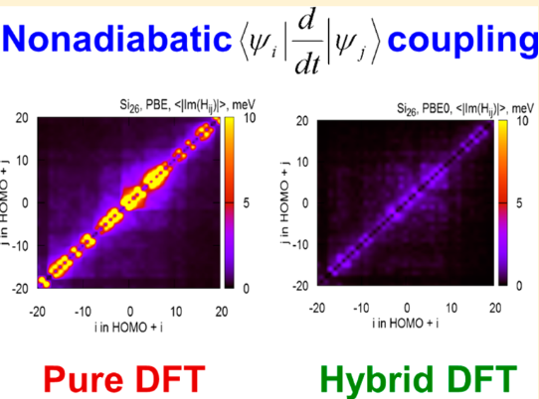
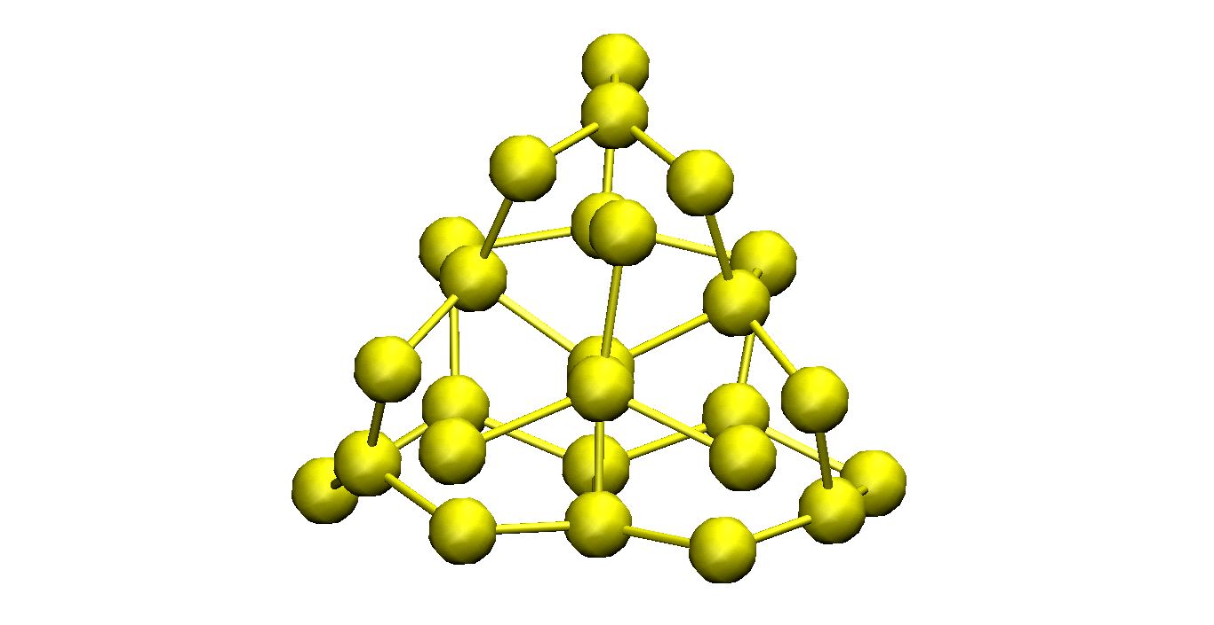
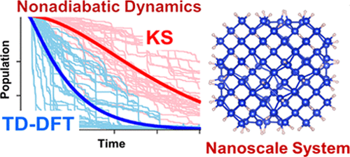
Libra in Materials Research: Quantum Dots and Molecules
Bare and hydrogenated Si clusters
Si nanoclusters: xTB approach
Lin, Y.; AVA JPCA. 2016, 120, 9028
Shakiba, M.; Stippel, E.; Li, W.; Akimov, A. V. JCTC 2022 18, 5157
Azobenzene and HFCO: Delta-SCF approach
H- and F-terminated Si nanoclusters: BLLZ
Pradhan et al. JPCM, 2018, 30, 484002
Smith, B.; Akimov, A. V JPCL 2020, 11, 1456-1465
Si and CdSe nanoclusters: TD-DFT vs. KS
Si nanoclusters and C₆₀: ML KS Hamiltonian mapping
Shakiba, M.; Stippel, E.; Li, W.; Akimov, A. V. JCTC 2022 18, 5157
Shakiba, M.; Akimov, A.V. JCTC 2024 20, 2992

Slide 12
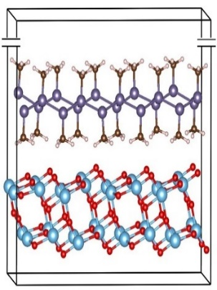
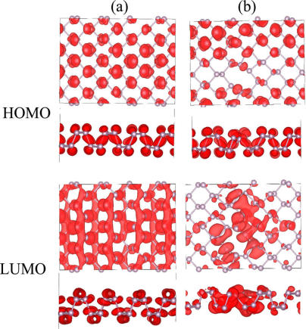
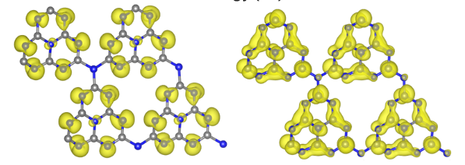
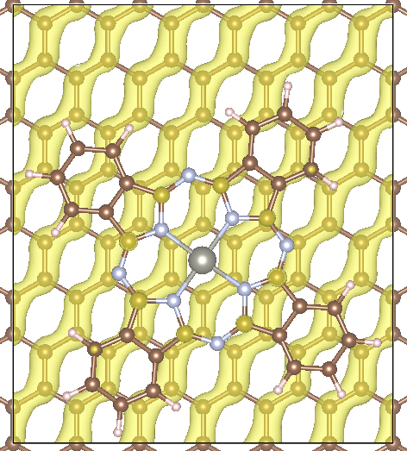
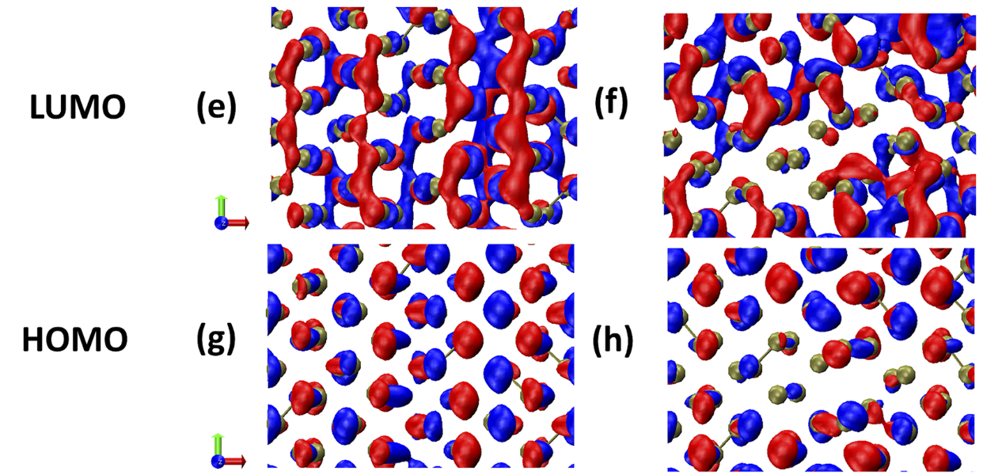
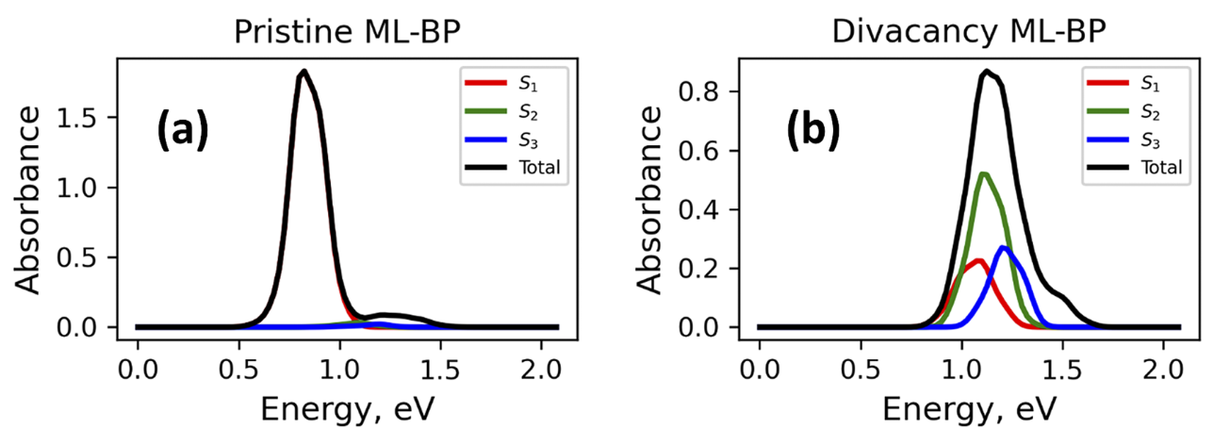
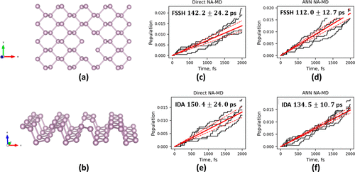
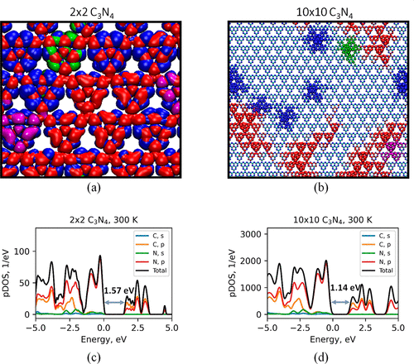
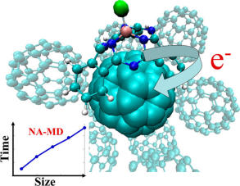
Libra in Materials Research: 2D materials and heterojunctions
Black phosphorus monolayers (Phosphorene)
g-C₃N₄
Long el al. JPCL 2016, 7, 653.
Agrawal, S.; Lin, W.; Prezhdo, O. V.; Trivedi, D. J. J. Chem. Phys. 2020, 153, 054701.
SiR/TiO₂ and GeR/TiO₂
Nijamudheen, A.; AVA JPCC, 2017, 121, 6520
ZnPc/graphene
Shakiba, M.; Stippel, E.; Li, W.; Akimov, A. V. JCTC 2022 18, 5157
Mehdipour, H.; Smith, B.; Rezakhani, A. T.; Tafreshi, S. S.; de Leeuw, N. H.; Prezhdo, O. V.; Moshfegh, A. Z.; Akimov, A. V. PCCP 2019 21, 23198-23208
Akimov, A. V. JCP 2021, 155, 134106.
Shakiba, M.; Akimov, A.V. JPCC 2023 127, 9083
SubPc/C₆₀
Akimov, A. V. JCTC 2016, 12, 5719–5736
Sato et al. PCCP, 2018, 20, 25275.
Akimov, A. V. JPCL 2021, 12, 12119–12128.
Yet another one is in progress (Hamid Zabihi)

Slide 13
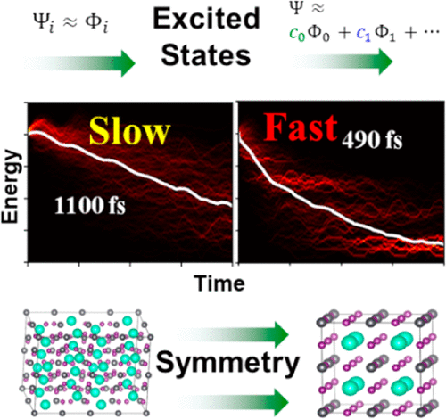





Libra in Materials Research: Periodic Solids
Lead halide perovskites: MB effects
Lead halide perovskites: SOC effects
Crystalline pentacene
Smith, B.; Shakiba, M.; AVA JPCL 2021, 12, 2444
Li, W.; Zhou, L.; Prezhdo, O. V.; Akimov, A. V. ACS Energy Lett. 2018, 3, 2159–2166.
Zhang, Q.; Shao, X.; Li, W.; Mi, W.; Pavanello, M.; Akimov, A. V. JPCM 2024 36, 385901
BZTS perovskites
MOFs: With xTB
Nijamudheen, A.; AVA JPCL 2018, 9, 248
Shakiba, M.; Stippel, E.; Li, W.; Akimov, A. V. JCTC 2022 18, 5157

Slide 14



Modular and User-friendly: C++/Python Interoperability
C++ layer
Python layer
User-Customized & Library
Python functions
Call by C++
Eigen 3
libra_py
Prototype and
Test (Discover)
Translate code
Use in C++ codes
Use in Python codes

Slide 15
Modularity: API Diversity and User-friendliness
The goal is to suite the needs of the users of various levels
Find a balance between simplicity and flexibility
Developer/Efficiency
Computing kinetic energy between Gaussians
g1 = PrimitiveG()
g2 = PrimitiveG()
g1.init(n1,m1,k1, a1, VECTOR(x1, y1, z1))
g2.init(n2,m2,k2, a2, VECTOR(x2, y2, z1))
kin = kinetic_integral(g1,g2)
double gaussian_overlap( AO* AOa, AO* AOb,int is_normalize, int is_derivs, VECTOR& dIdA, VECTOR& dIdB, vector<double*>& auxd,int n_aux);
double gaussian_overlap( AO* AOa, AO* AOb,int is_normalize, int is_derivs, VECTOR& dIdA, VECTOR& dIdB );
double gaussian_overlap(AO* AOa, AO* AOb,int is_normalize);
double gaussian_overlap(AO* AOa, AO* AOb);
Benchmarked against PyQuante
p1 = PyQuante.PGBF.PGBF(a1,(R1.x,R1.y,R1.z),(n1,m1,k1))
p2 = PyQuante.PGBF.PGBF(a2,(R2.x,R2.y,R2.z),(n2,m2,k2))
val_ref = p1.kinetic(p2)
User/Convenience

Slide 16

Passing Python functions
C++
Python
Models
Implementation
Interface

Slide 17
How it works with Sampling
vector<MATRIX> metropolis_gau
(Random& rnd, bp::object target_distribution,
MATRIX& dof, bp::object distribution_params,
int sample_size, int start_sampling, double gau_var){
Metropolis Algorithm
double p_old =
bp::extract<double>( target_distribution(s_old, distribution_params) );
…
}
def test():
q = MATRIX(ndof, 1)
output = metropolis_gau( piab, q, params, ...)
User calls the sampling
Output
def piab(q, params):
User defines the
probability density
C++
Python

Slide 18
Sampling Example
q = MATRIX(1,1); q.set(0, 0.5)
params = {"k":1.0, "m":2000.0, "states":[0], "coeffs":[1.0]}
Nsamp = 1000000; Nstart = 50000
sampling = metropolis_gau(rnd, HO_sup, q, params, Nsamp,Nstart, 0.05)
bin(sampling, -1.5, 2.0, 0.01, 0, 0, "_distrib-1.txt")
User defines how to
run the MC sampling
def HO_sup(q, params):
k = params["k"]; m = params["m"];
states = params["states"]; coeffs = params["coeffs"]
x = q.get(0)
sz = len(states)
p = 0.0
for n in xrange(sz):
p = p + coeffs[n] * ket_n(x, states[n], k, m)
p = p * p
return p
User defines what
probability distribution
function is to be sampled
The dynamical algorithm is in C++, but…
Don’t need to implement the model in C++

Slide 19


















Initial Conditions: Metropolis Sampling
Particle in a box
Harmonic oscillator
$$ψ_{n}\left(q\right)\sim \sin\left(\frac{πnq}{L}\right)$$
$$ψ_{n}\left(q\right)\sim H_{n}\left(q\sqrt{α}\right)\exp\left(−\frac{αq^{2}}{2}\right)$$
$$\left.|1\right\rangle$$
$$\left.|2\right\rangle$$
$$\left.|1\right\rangle$$
$$\left.|0\right\rangle$$
$$\left.|10\right\rangle$$
$$\left.|0\right\rangle +\left.|1\right\rangle$$
$$\left.|25\right\rangle$$
$$\left.|0\right\rangle −\left.|1\right\rangle$$

Slide 20
Community Tool: Code Contributions/Integration
Sophya Garaschchuk – quantum trajectory guided Gaussians (QTAG)
src/libra_py/dynamics/qtag
Amber Jain – Hierarchical Equations of Motion (HEOM)
src/dyn/heom
https://github.com/amber-jain-group-iitb/heom_amber
Xiang Sun – (Non)-equilibrium Fermi Golden Rule (FGR)
src/fgr
https://github.com/tsiangsun/FGR
Craig Martens – quantum trajectory surface hopping (QTSH)
in progress
Nandini Ananth – Initial value representation (IVR)
src/ivr
https://github.com/AnanthGroup/SC-IVR-Code-Package
Rebecca Gieseking – INDO NACs in MOPAC
in progress
https://github.com/Devon333
… and more

